Slide 1

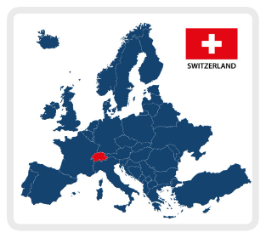
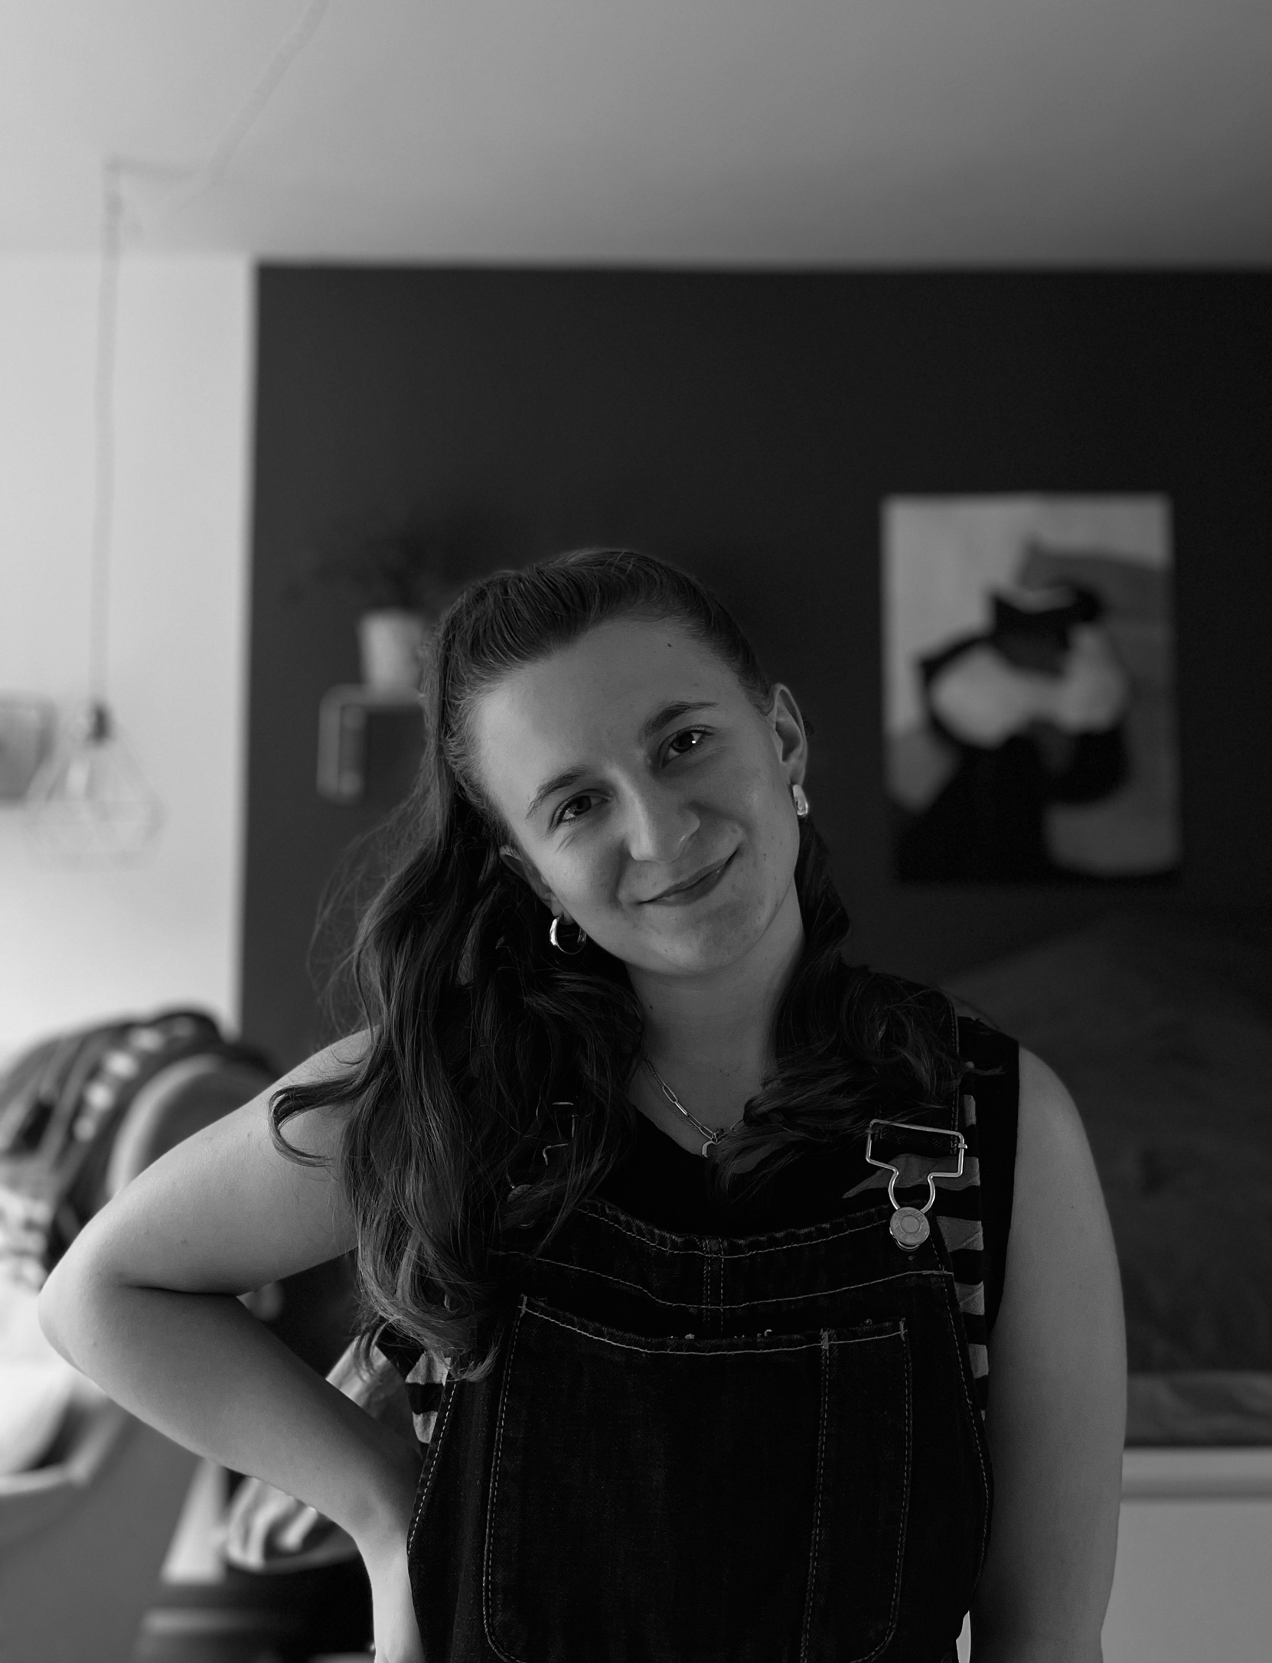
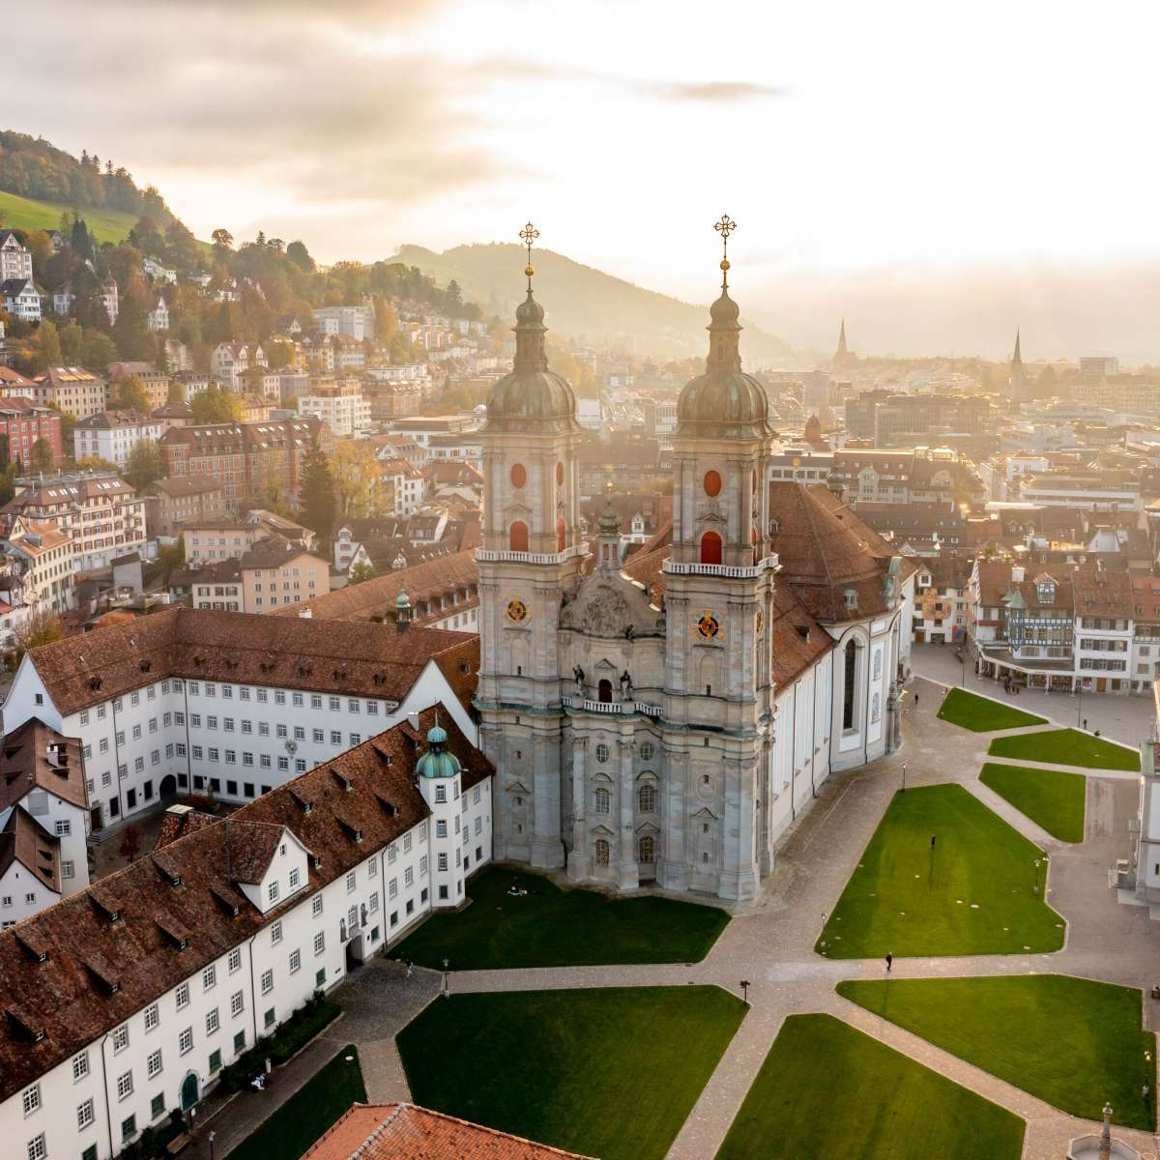



Paula Graf
University: Eastern Switzerland University of Applied Sciences
Study program: Physiotherapy
Year of study: 3rd semester
City: St. Gallen, Switzerland
Motto for life: the world is a stage. So keep writing your own script.
Hobbies: reading, cooking, baking, be creative, photography, different sport activities
Your expectations from the summer school:
I want to learn about different aspects of sustainability and how we can apply them to our lives.
The city where I live and study
Karlsruhe
31 August to 11 September 2026

